Slide 1
Group 9 Demo Presentation
Andrew Quinn, Nihar Shukla

Slide 2
Team Members
Andrew Quinn - Database developer, tester, documentor
Nihar Shukla - Front-end developer, back-end developer

Slide 3
System Description, Scope, and Goal
Goal: Create a full-featured financial application from existing open-source code to enable users to track their personal finances quickly and easily
System Description: A MERN stack web application built on the MVC software design pattern and using Atlas as the database host
Scope: User account creation/log-in, user data persistence, a UI that allows users to track their budgets and financial health, data visualizations

Slide 4
User Stories
1. As a user, I want to create an account, so that I can access my financial tracking information.
2.As a user, I want to add my income and expenses, so that I can track my monthly and yearly financial activities.
3.As a user, I want to see my financial data represented in graphs, so that I can easily understand my financial patterns
4.As a user, I want to categorize my income and expenses, so that I can understand where I am earning/spending money
5.As a user, I want to import and export my financial data, so that I can back it up and transfer it between services when needed.

Slide 5
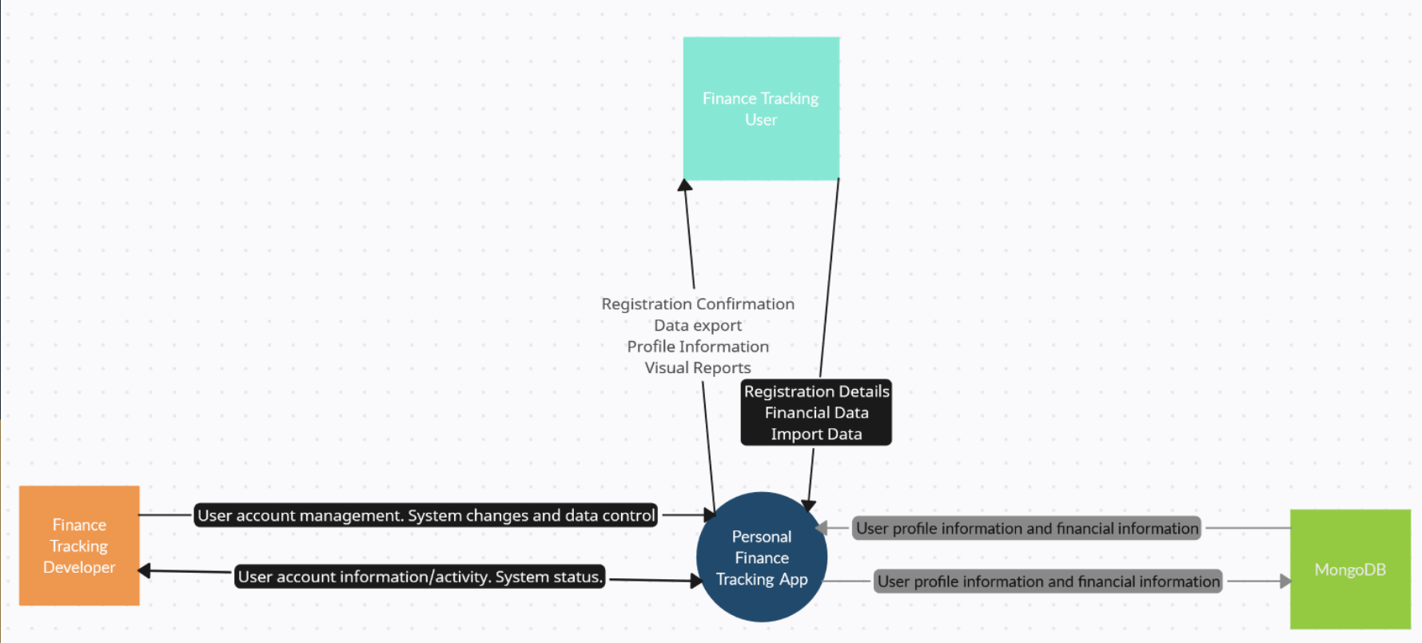
Context Diagram

Slide 6
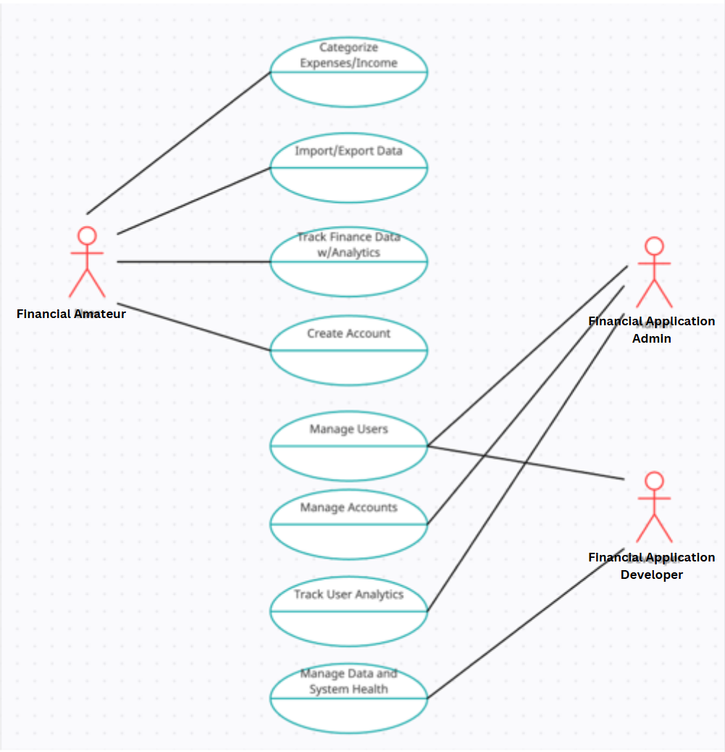
Use Case Diagram

Slide 7
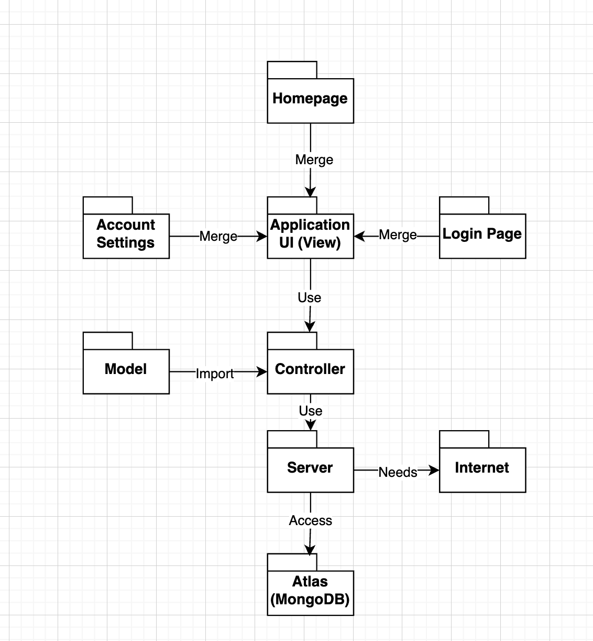
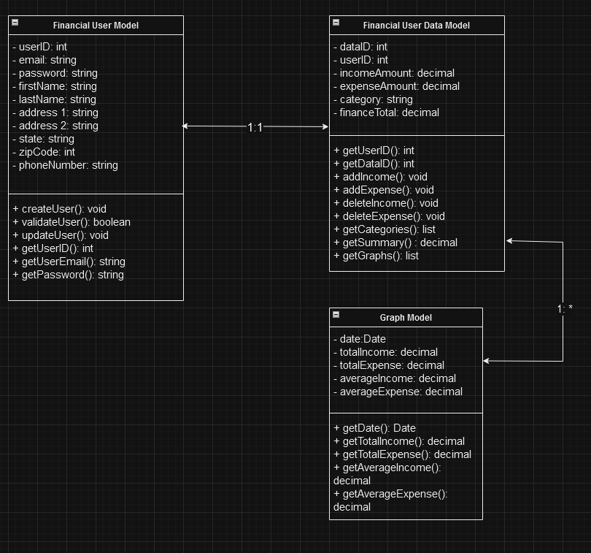
Other UML Diagrams

Slide 8
State of Development: Product Backlog
Completed:
Sprint 0 - Data Modeling
Sprint 1 - Account Creation and User Profile Page
Sprint 2 - User Summary Page and Income & Expense Page
Sprint 3 - User Data Visualization
Backlog:
Sprint 3 - Import/Export Data Feature
Sprint 4 - Project Documentation

Slide 9
Lessons Learned
Organization and time management are key
Planning saves time in the long run
Working with existing code is often more difficult than starting over

Slide 10
Next Steps
Application testing
Refinement and finalization of existing code per testing results
Refine documentation

Slide 11
GitHub Link
https://github.com/Sylnus/Personal-Finance-Tracking-App
Demo Video(UNCC Email): https://drive.google.com/file/d/1VfDd1VR8G-lyzM63fq8IUyngFHsTjCZR/view?usp=sharing

